Slide 1
MEMORY - PUZZLE GAME OF NUMBER PAIRS
PROJECT NUMBER: 6
(Computer Gaming)
project by
B.Lekha
21BQ1A0420

Slide 2
Abstract
The memory game, or concentration, as it is sometimes called, is a popular card game played by children and adults around the world. Good memory is one of the qualities required in order to succeed in it. This, however, is not enough. When it is assumed that the players have perfect memory, the memory game can be seen as a game of strategy. The game is analyzed under this assumption and the optimal strategy is found. It is simple and perhaps unexpected.
In contrast to the simplicity of the optimal strategy, the analysis leading to its optimality proof is rather involved. It supplies an interesting example of concrete mathematics of the sort used in the analysis of algorithms. It is doubtful whether this analysis could have been carried out without resort to experimentation and a substantial use of automated symbolic computations

Slide 3

Introduction
Playing memory game is one of the best way to train your brain.
. Memory games keeps
your mind active and
computer games also
improves skills
.

Slide 4
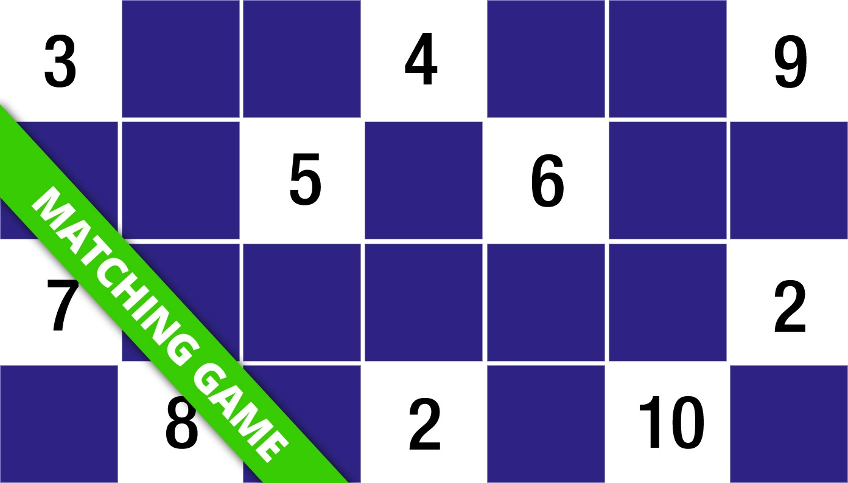
Modules used:
. turtle
random
freegames

Slide 5
MODULES:
Turtle:
Turtle is a special feathers of Python. Using Turtle, we can easily draw in a drawing board. First we import the turtle module. Then create a window, next we create turtle object and using turtle method we can draw in the drawing board.
2. random:
In Python random is a module that is available in the NumPy library. This module returns an array of specified shapes and fills it with random floats and integers.
3. freegames:
Free Python Games is an Apache2 licensed collection of free Python games intended for education and fun. The games are written in simple Python code and designed for experimentation and changes. Simplified versions of several classic arcade games are included.

Slide 6

Design
Python
We use python to write code for the project.
Reasons:
Python is extremely easy to handle .
Python has wide-range of packages which makes code to write in efficient way.
Performing data analysis and designing neural networks is easier in python.
Python has very good community support.

Slide 7
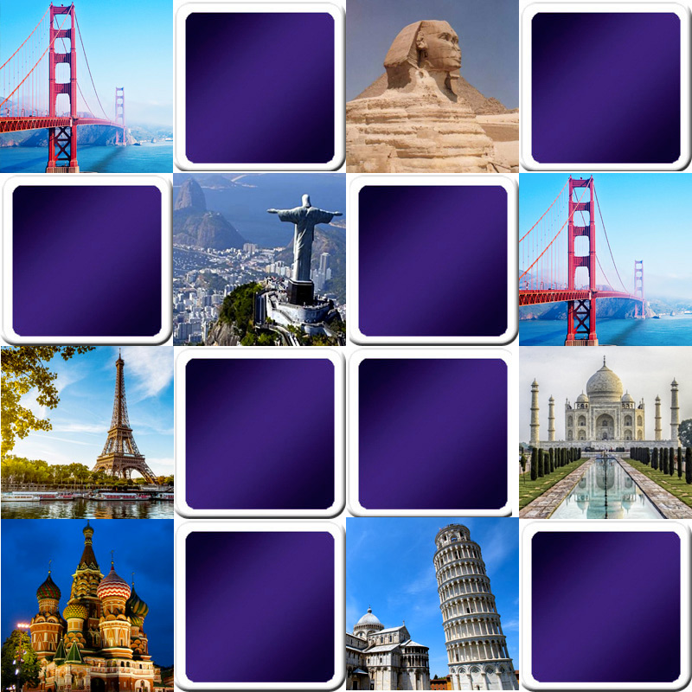
BLOCK DIAGRAM:
ex
Install python
Install the required modules
Execute the code
Graphical output
MEMORY GAME

Slide 8

Implementation
We used python 3.11 as our primary IDE , it is easy to write the code and execute and also to install modules.
As it is easy to work and install modules

Slide 9
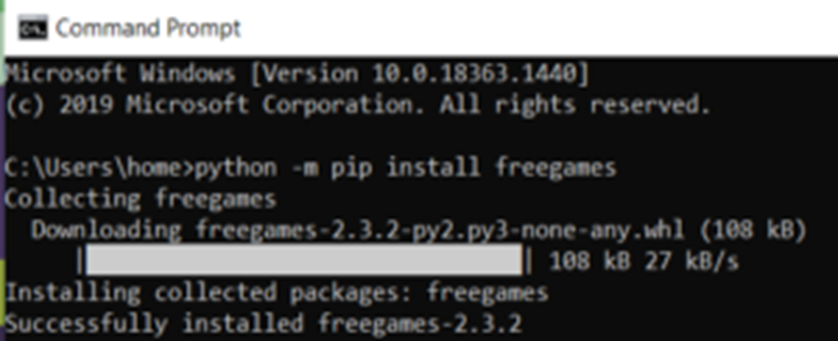
Implementation
Installing freegames module:

Slide 10
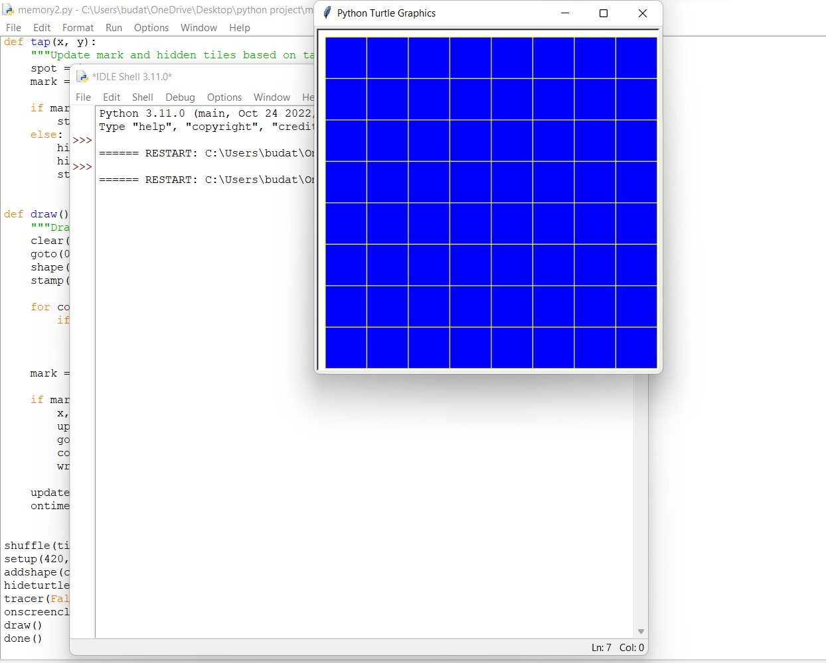
Results

Slide 11
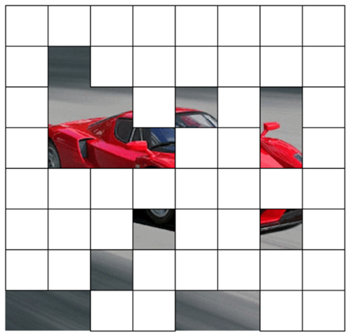
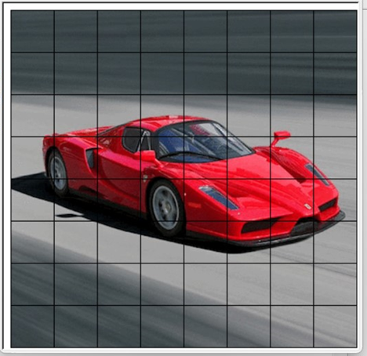
Outputs:

Slide 12
References
[1]. S.H. Gerez .An analysis of the “Memory” game (in Dutch) 65-afternoon project report, Department of Electrical Engineering, University of Twente, Holland (June 1983)
[2] R.L. Graham, D.E. Knuth, O. PatashnikConcrete Mathematics: A Foundation for Computer ScienceAddison-Wesley, Reading, MA (1989)
[3] D.H. Greene, D.E. Knuth ,Mathematics for the Analysis of Algorithms (2nd edn.), Birkhäuser, Basel (1982)
[4] I.N. Stewart , Concentration: a winning strategy
Scientific American, 265 (4) (October 1991), pp. 103-105
[5] Oxford English Dictionary (2nd edn.), Oxford Univ. Press, Oxford (1989)

Slide 13
THANK YOU

